Slide 1
Construction
Explain the hazards during construction
Discuss how to effectively utilize site planning
Determine the separation required between buildings

Slide 2
Historic Fire
Caracas Tower

Slide 3
Construction
Greater fire risk than at other times
  Incomplete or missing fire barriers
  Limited water supplies
  Extraordinary combustible sources
  Limited ingress and egress routes
  Extraordinary ignition sources
  Extraordinary security conditions
Earlier installation of fire protection systems could be beneficial

Slide 4
Construction
Limited notification
Human activities
  Smoking
  Housekeeping
  Open flames
  Intentional fires by unauthorized people

Slide 5
Construction
Life safety
  Stairway (temporary or permanent) required when construction exceeds 40 ft above lowest level of fire department access
  Within one floor of the highest point of construction having secured decking or flooring
  Means of egress must be maintained at all times

Slide 6
Why Talk About Site Planning?
Important issues affect:
  Value and usability to the owner
  Life safety of occupants
  Cost
  Effects upon neighboring properties

Slide 7
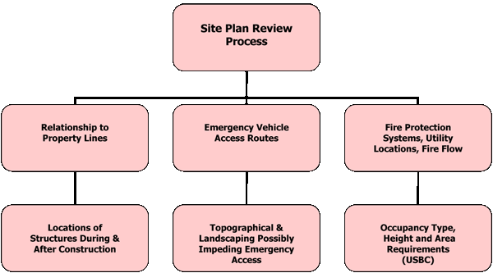
Site Planning

Slide 8
Interior Layout
Relative use of doors, walls and other elements of compartmentation
Relative complexity
  Circulation patterns are important in emergency evacuation
Building height
  Ladder trucks only reach about 7 floors
  Interior evacuation above the 7th floor
Security features

Slide 9
Transportation
How accessible is the building?
Time is vital for fire department
  How quickly can the fire department arrive
  What traffic issues could delay arrival

Slide 10
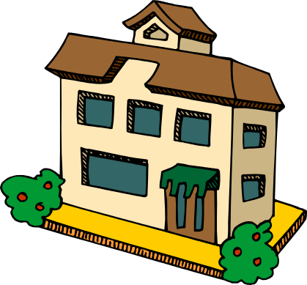

Accessibility for Fire Department Operations
Access to the building
  Fire lanes
  Windowless areas
  Concealed spaces
  Interior access

Slide 11
Water Supply
Critical issues
  Residual pressure
  Volume
  Reliability
High-rise pressure requirements
Number of sprinklers that might activate
Location of hydrants

Slide 12
Exposure Protection
Fire in another building a threat
  Radiation
  Flame impingement
  Flying debris
Requirements in IBC

Slide 13
Exposure Protection
A/a+A_{a}/a_{a}≤1.0
Where:
A=Area of protected openings
a=Allowable area of protected openings
A_{a}=Area of unprotected openings
a_{a}=Allowable area of unprotected openings
Separation Distance (ft)
 | < 3 | 3 to <5 | 5 to <10 | 10 to <15 | 15 to <20 | 20 to <25 | 25 to <30 | 30+
UPNS | NP | NP | 10 % | 15 % | 25 % | 45 % | 70 % | UL
UPS | NP | 15 % | 25 % | 45% | 75 % | UL | UL | UL
P | NP | 15 % | 25 % | 45 % | 75 % | UL | UL | UL

Slide 14
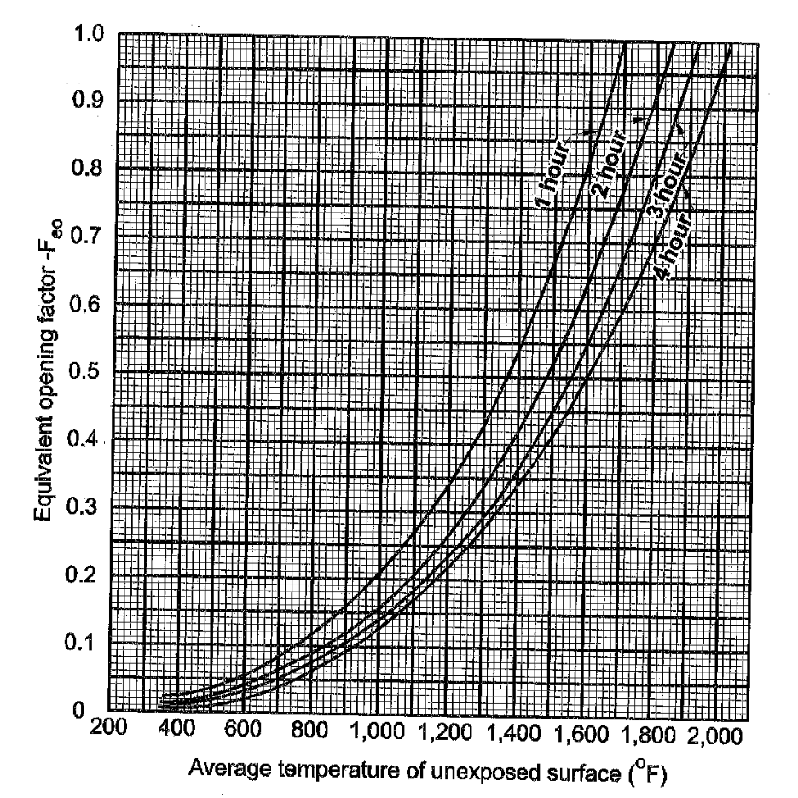
Exposure Protection
A_{e}=A+(A_{f}*F_{eo})
Where:
A_{e}=Equivalent area
A=Area of protected openings
A_{f}=Area of wall surface excluding openings
F_{eo}=Equivalent opening factor

Slide 15
Design of the Building
Compartmentation
Detection, alarms, and communications
Automatic fire suppression
Egress systems
Ventilation systems

